Slide 1
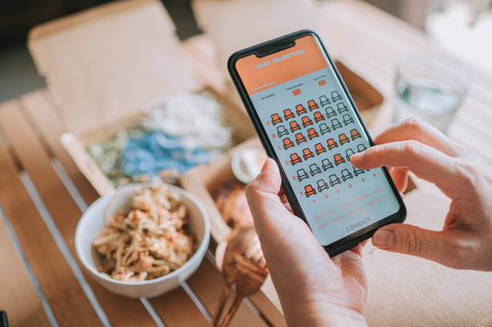

C.V. Raman Global University
C++ Project
on
DIGITAL TICKET BOOKING AND RESERVATION SYSTEM
Team Members:
Samer Nayak : CL20250106019052110
Ajay Kumar Marandi : CL202501060188235
Under the guidance of:
Chandrasekhar Parida : CL2025010601934852
Satyajit Mishra : CL20250106019060118
Md. Sikandar Sir
Satyanand Kumar Chauhan: CL20250106019059117

Slide 2
INTRODUCTON
An Online Ticket Booking System allows users to book tickets for various services like movies, trains, buses, and concerts through an automated platform.
It replaces traditional manual booking with a faster, more convenient, and user-friendly approach.
Users can register, log in, select tickets, choose seats, and get confirmation with a unique booking ID.

Slide 3
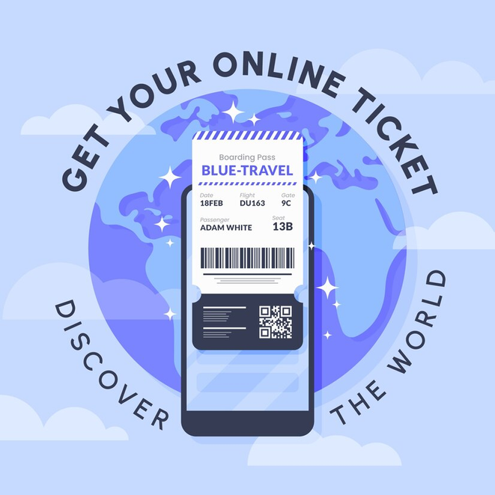
Objectives
The main goals of this project are:
User Authentication: Enable user registration and login.
Ticket Selection: Allow users to choose ticket types (Movie, Train, Bus, Concert).
Seating Preference: Provide options for General, VIP, First-Class, and Economy.
Booking Confirmation: Generate a unique booking ID for every transaction.
User-Friendly Interaction: Simple command-line input and output.

Slide 4
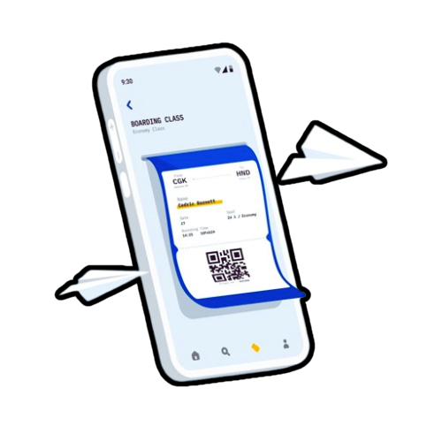

System Features
of an Online Ticket Booking

Slide 5
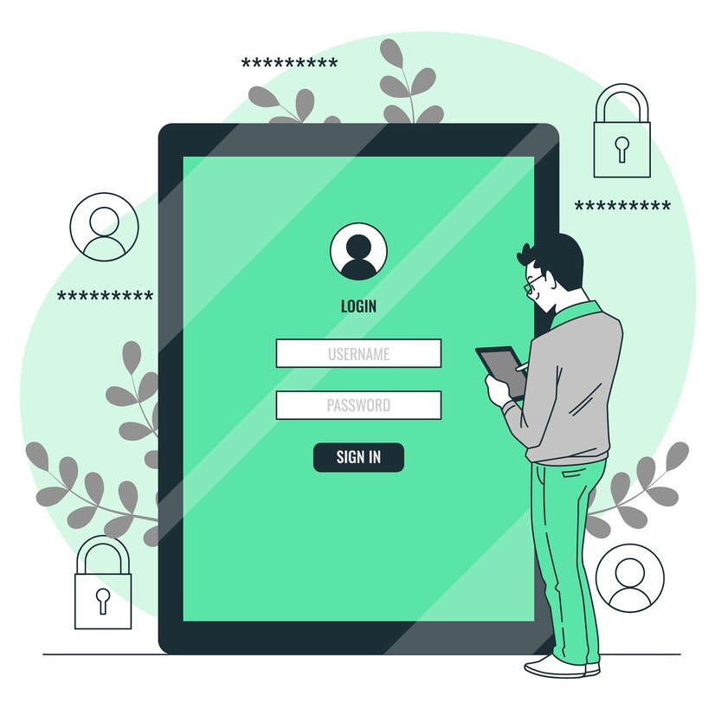
User Authentication
Users can register with a username and password.
Secure login system to verify user credentials.

Slide 6
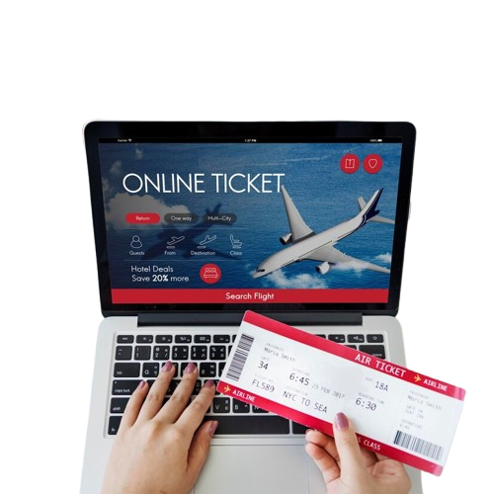
Ticket Booking Process
Users can select different ticket types.
Allows entering event details (e.g., movie name, train destination).
Different seating classes to choose from.
1️⃣ User Login/Register – The user logs in or registers an account.
2️⃣ Select Train Ticket – Choose "Train Ticket" from the options.
3️⃣ Enter Train Name – Example: "Rajdhani Express."
4️⃣ Choose Seat Type – Options: General, VIP, First-Class, Economy.
5️⃣ Enter Number of Tickets – Example: 2 tickets.
6️⃣ Select Seat Location – Example: Row B, Seat 12.
7️⃣ Booking Confirmation – Displays all ticket details.

Slide 7
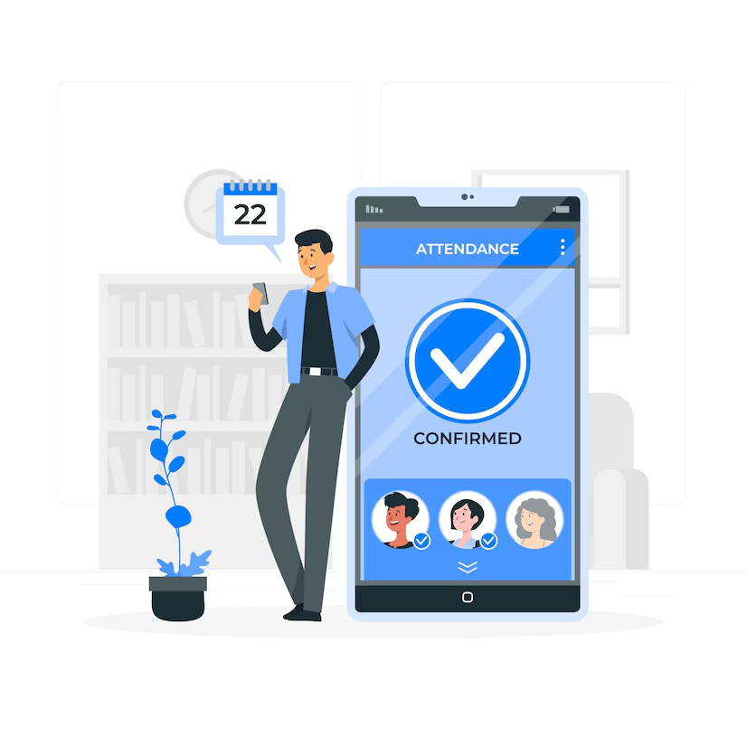
Booking Confirmation
The system generates a random 5-digit booking ID.
Displays ticket details like name, ticket type, seat selection, and event.
Train Ticket

Slide 8
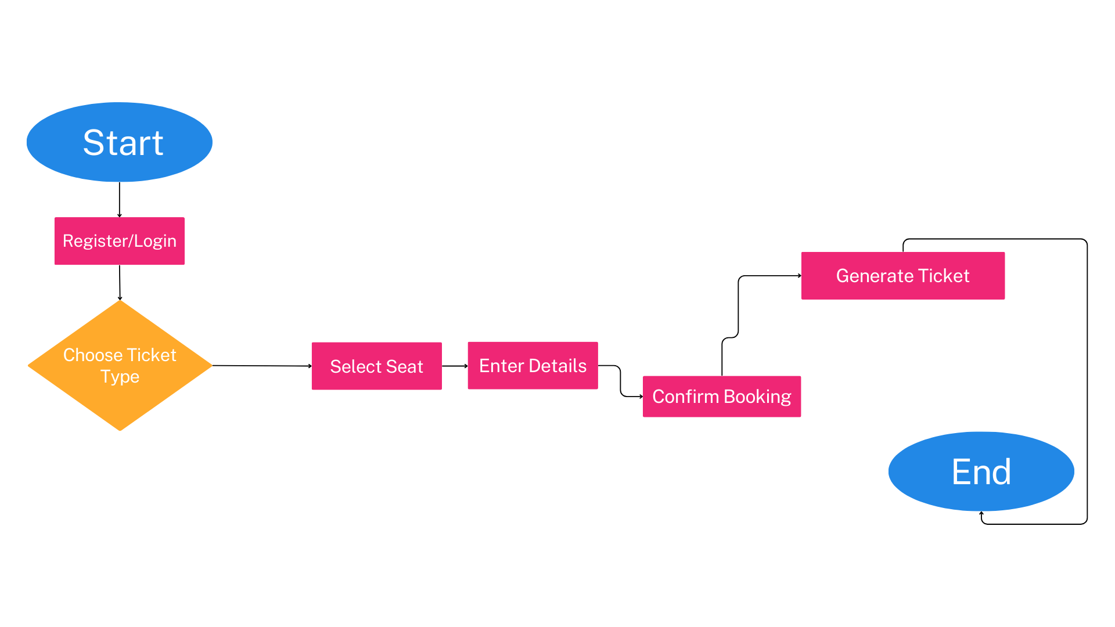
Flowchart of the System

Slide 9
Code Implementation
This project is implemented using C++ and includes the following core functionalities:
🔹 User Registration & Login
registerUser() – Stores user credentials.
loginUser() – Verifies username and password.
🔹 Ticket Booking Process
showTicketOptions() – Displays available ticket types.
showSeatOptions() – Lists seating preferences.
generateBookingID() – Creates a unique 5-digit ID for each booking.
🔹 Ticket Confirmation Output
Displays the final ticket details in a formatted way.
Logos & Icons

Slide 10
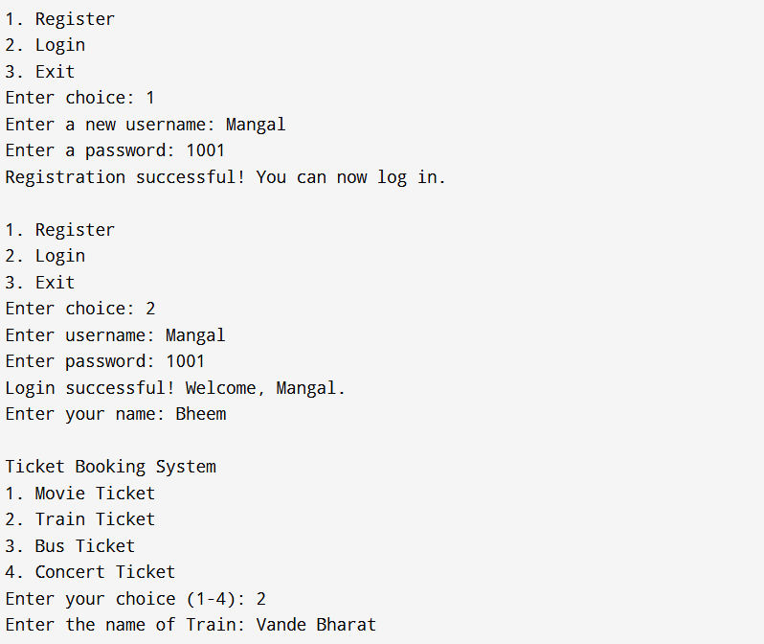
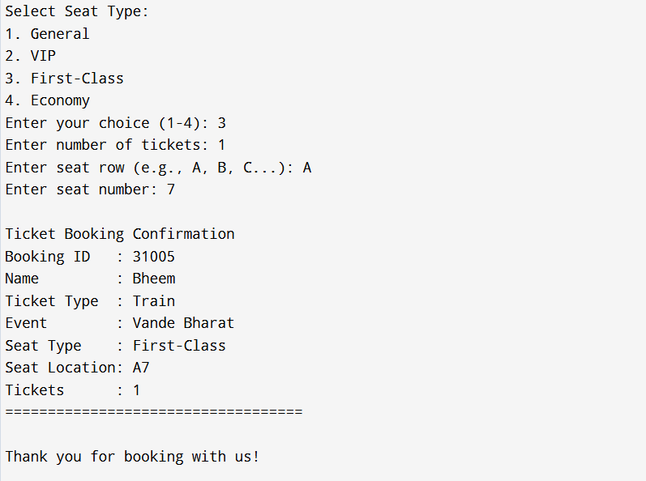
Sample Output (Demo)

Slide 11
Advantages
✔ Easy to Use – Simple input-output interaction.
✔ Time-Saving – No need for manual booking.
✔ Unique Booking ID – Prevents duplication.
✔ User Authentication – Secure login system.

Slide 12
Limitations & Future Enhancements
Current Limitations
❌ No database (user data is lost after exit).
❌ Only works on the command line (no GUI).
Future Enhancements
✅ Develop a web-based or mobile app version for better UI.
✅ Integrate payment options (e.g., online transactions).

Slide 13

THANK YOU

